Slide 1




Southern New England Industrial Assessment Center at the University of Connecticut and the University of New Haven
ECE 3101
Signals and Systems
Module 2: Continuous-Time LTI System
Lecture M2-1: Introduction and Mathematical Formulation

Slide 2


Program Overview
Mission and Goals
Team and Partners
Get Involved
Our Process

Slide 3
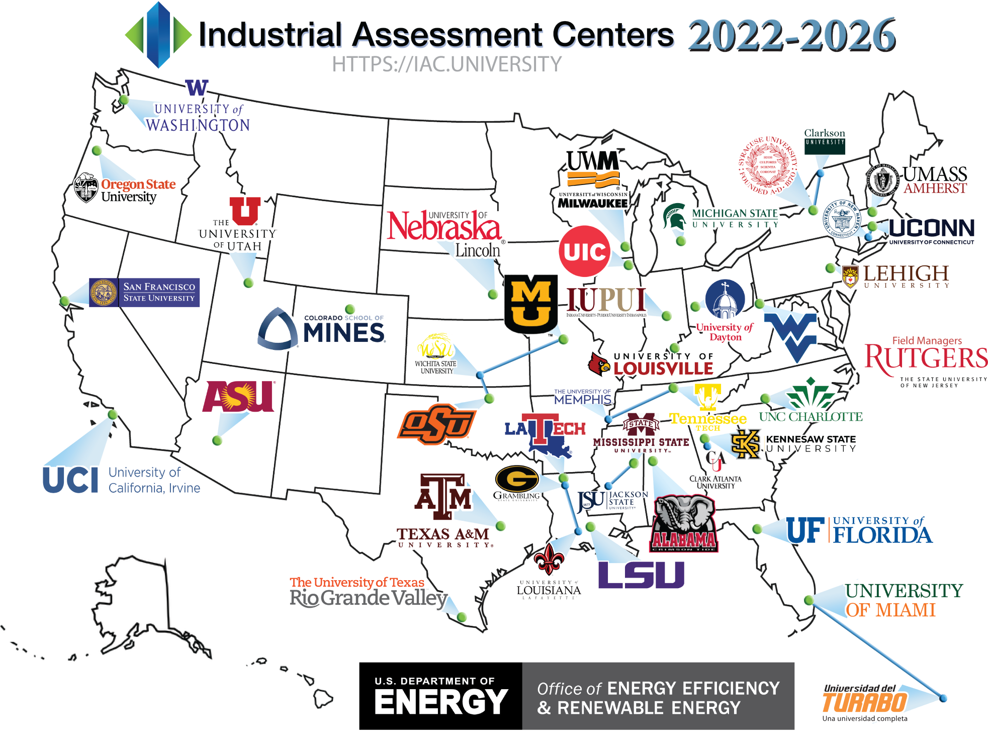



IAC Program Overview
What is IAC
Primary objective
Nationally (since 1976)
Funded by DOE
Energy assessments in manufacturing plants by University faculty-led teams of engineering students
- Help small-medium manufacturers save energy costs
- Educate energy engineering students – firsthand experience
Impact
19,500 no-cost technical assessments conducted
150,000 associated recommendations
>$130,000 average potential savings
31 Universities
9 performing commercial buildings assessments

Slide 4
Program Overview
Mission and Goals
Team and Partners
Get Involved
Our Process

Slide 5
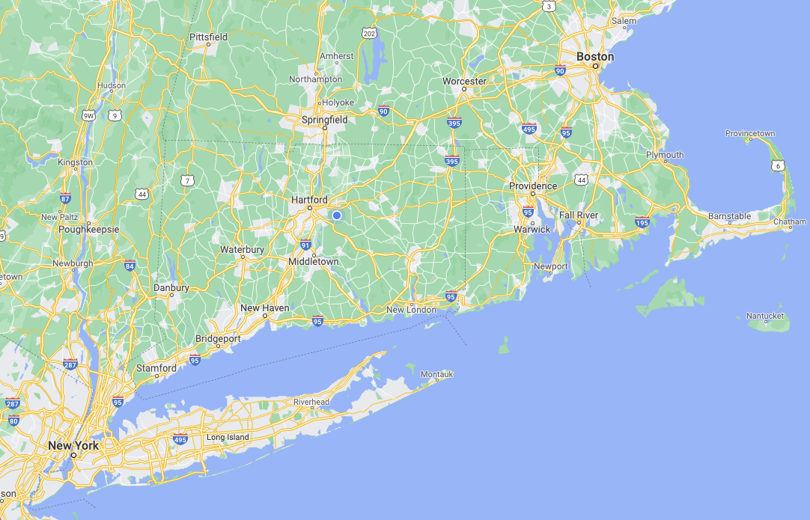
Mission and Goals
Late Spring ’22 - Start Assessments
Yearly Goals
UMass IAC
20 on-site assessments (Including 2 wastewater treatment facility per year)
Recruit and train 10 students into the program
Education for non-participating clients
UConn
Main Center
University of New Haven
Satellite Center

Slide 6
Program Overview
Mission and Goals
Team and Partners
Get Involved
Our Process

Slide 7









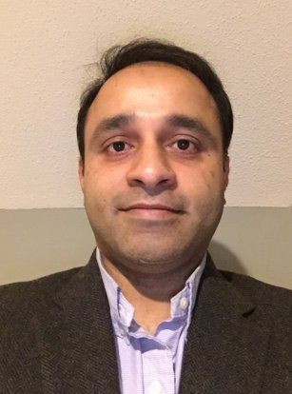
Meet Our Team of Experts
Director at UCONN (Main Center)
Liang Zhang, PhD, Assoc. Professor
Elec. and Comp. Engr.
liang.zhang@uconn.edu
Director of Operations
Amy Thompson, Assoc. Prof.-in-Res.
Systems Engineering
amy.2.thompson@uconn.edu
Director at UNH (Satellite Center)
Ravi Gorthala, PhD,
Mech. Engr
RGorthala@newhaven.edu
Affiliated Faculty Member
Ugur Pasaogullari, PhD, Professor
Mech. Engineering, ugur.pasaogullari@uconn.edu
Affiliated Faculty Member
Nadiye Erdil, PhD, Associate Professor
Ind. Engr., NErdil@newhaven.edu
Affiliated Faculty Member
Baikun, Li, PhD, Professor
Civil and Environmental Engr., baikun.li@uconn.edu
Affiliated Faculty Member
Ibrahim Baggili, PhD, Associate. Prof.,
Computer Science, IBaggili@newhaven.edu
Affiliated Faculty Member
Haitham Ghalwash, PhD, Assistant Prof.-in-Residence
Comp. Science and Engr., haitham@uconn.edu
Affiliated Faculty Member
Mohamad Nassar, PhD, Assistant Professor
Cyber Security, MNassar@newhaven.edu
External Consultant, Director at DNV
Satyen Moray
IAC Alumni

Slide 8









Meet the Team: Students & Staff
Communication/Administration Coordinator
Shruthi Nagaraj
shruthi.nagaraj@uconn.edu
Student Lead
Prathamesh Patil, Graduate Student
Mechanical Engineering
Student Lead
Yishu Bai, Graduate Student
Electrical and Computer Engineering
Student Assessor
Mia Langston, Junior
Chemical Engineering
Student Assessor
Colby Hoffman, Junior
Management and Engr for Manufacturing
Student Assessor
Julia De Oliveira, Senior
Mechanical Engineering
Student Assessor
Alain Olhaberry, Senior
Chemical Engineering
Student Assessor
Nicholas Satta, Junior
Electrical and Computer Engineering
Student Assessor
Amogh Garudadwajan, Sophomore
Computer Science and Engineering

Slide 9








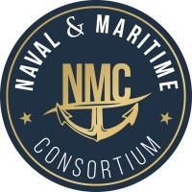




IAC Partnership

Slide 10
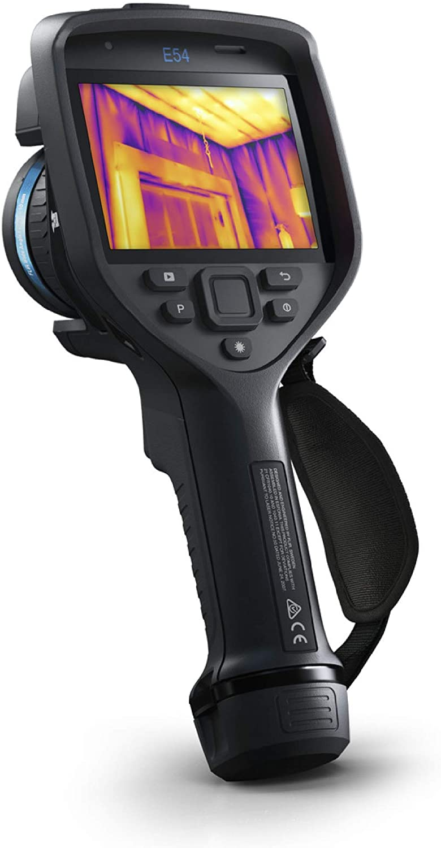
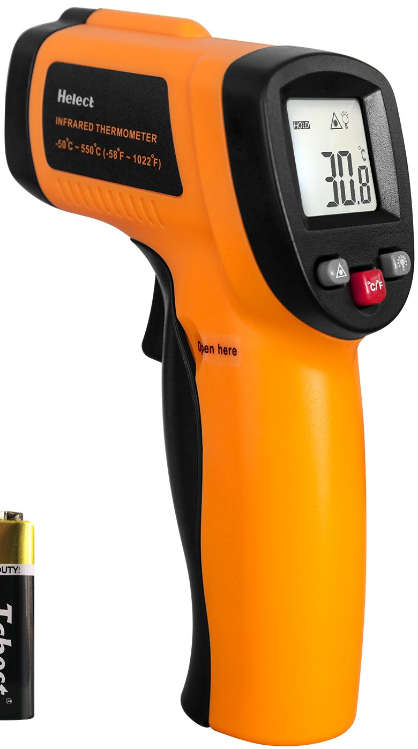
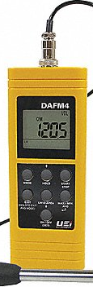
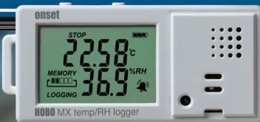

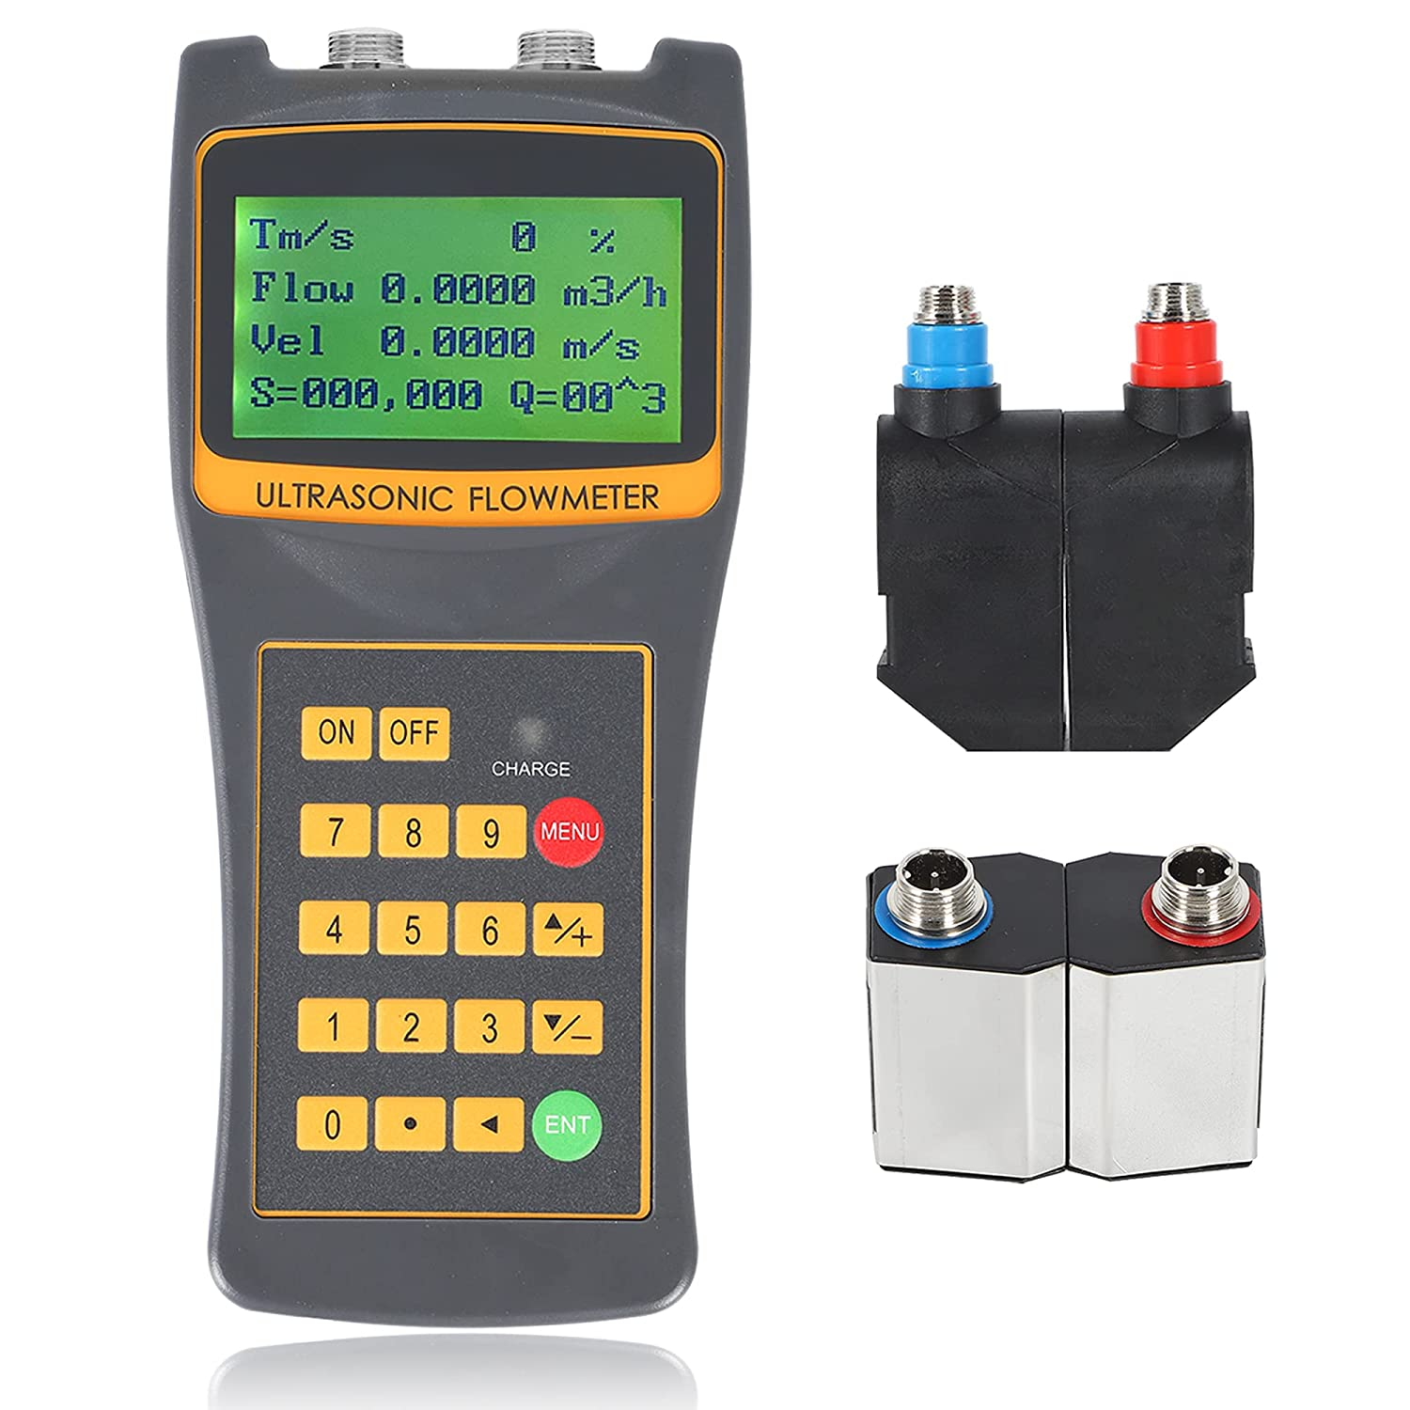
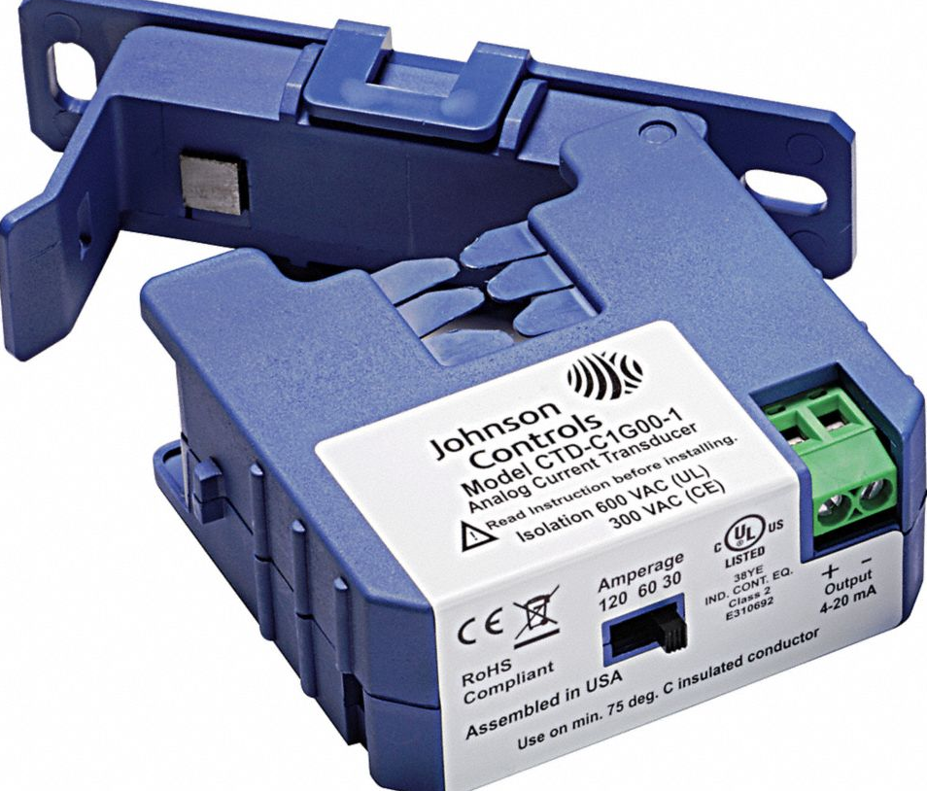
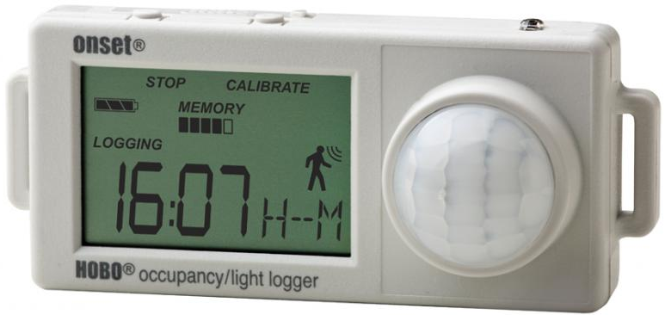
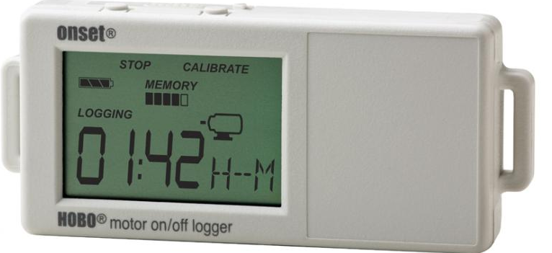
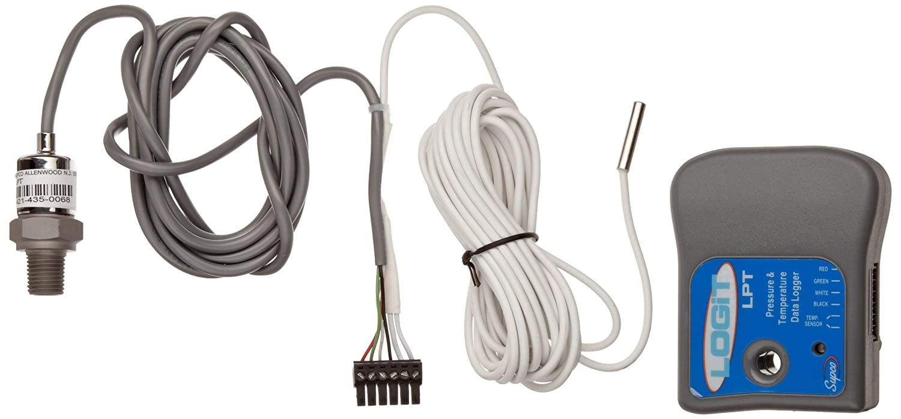
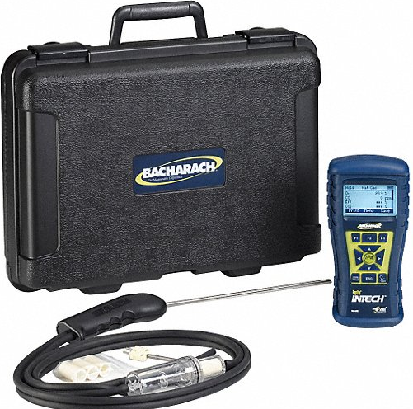
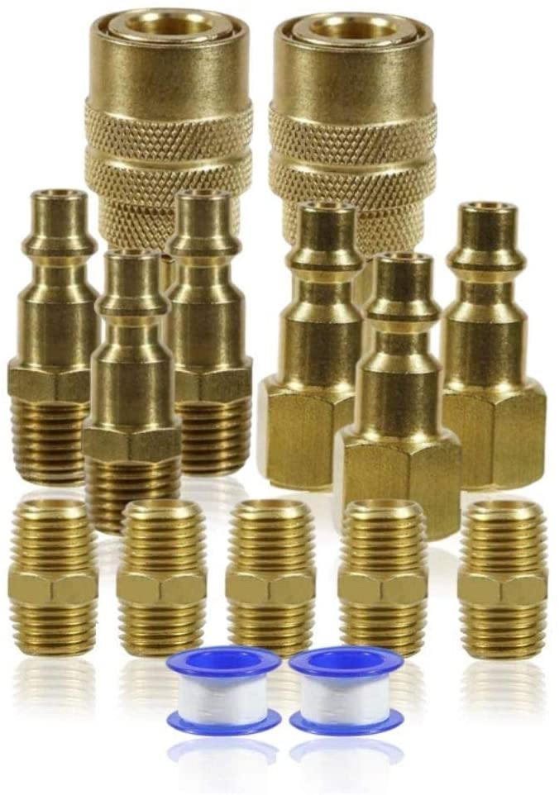
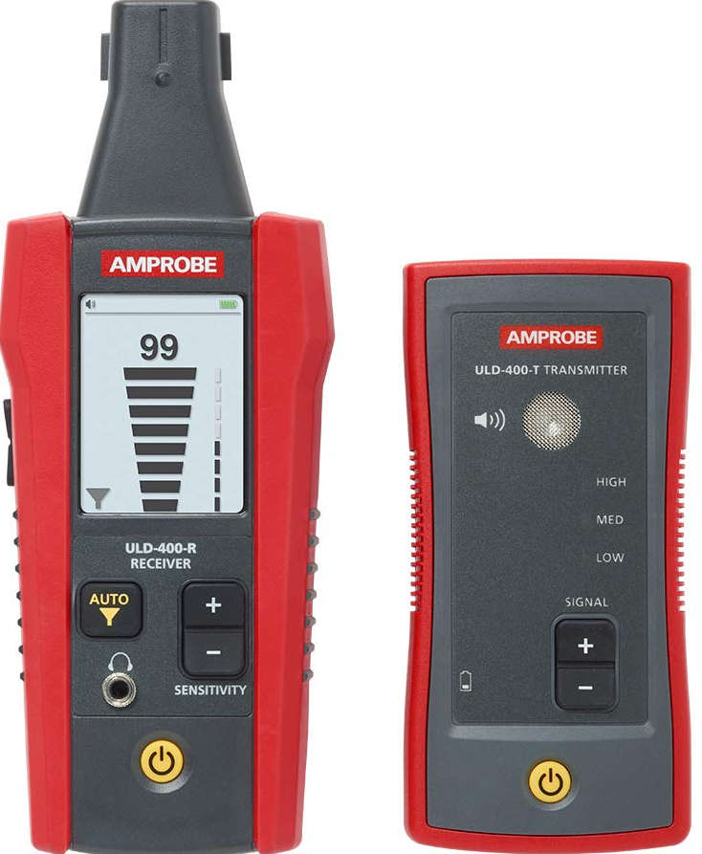

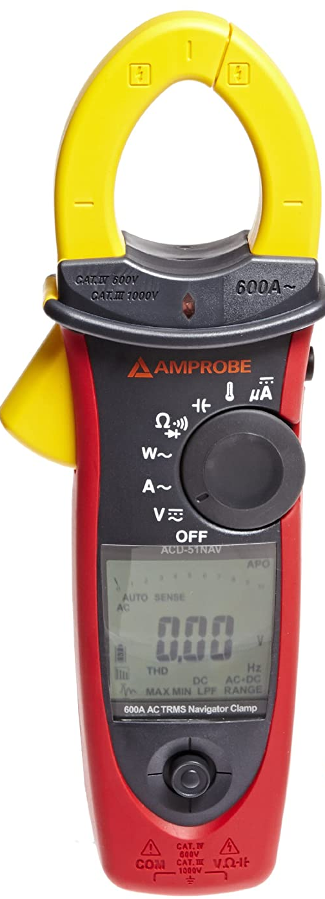
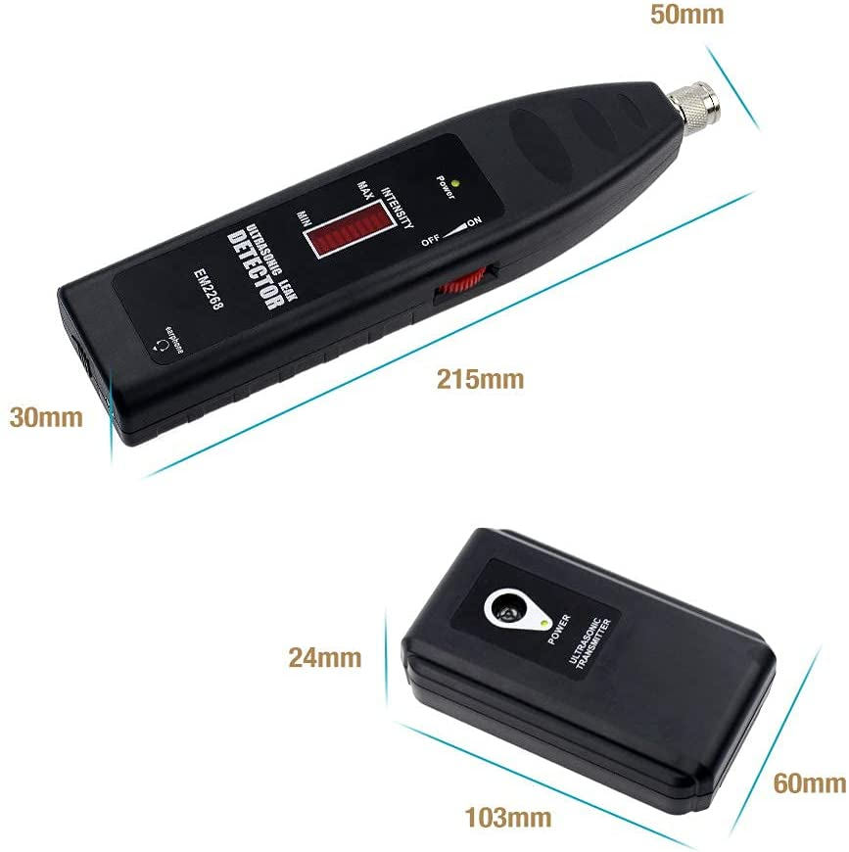
Equipment
Equipment
Temperature/Humidity Data Logger
IR Thermal Camera
IR Laser Temperature
Gun
Light Meter
Ultrasonic Flow Meter
Anemometer
Current Transducer
Occupancy/Light
Data Logger
Pressure/ Temperature
Data Logger
Motor On/Off Data Logger
Air Tool Fittings
Ultrasonic leak Detector and Transmitter
3-Phase Digital
Clamp Multimeter
Power Clamp Meter
Combustion Analyzer

Slide 11
Program Overview
Mission and Goals
Team and Partners
Get Involved
Our Process

Slide 12
How to Get Involved: Eligibility
Location
Industry code
Size
Other
In CT, RI, Long Island, or NYC
Facilities in MA can contact UMass IAC (kosanovic@umass.edu)
SIC code:20 - 39
NAICS code: 31 – 33
Agriculture: NAICS 11 excluding 111, 113, 114.
Mining, NAICS 21 excluding 213.
Wastewater: NAICS 22
Annual sales under $100 million
Fewer than 500 employees
Annual utility bills over $100k but less than $3.5 million
No in-house energy professional on staff
For wastewater treatment, size limit of 3-10 million gallons/day
Previous IAC assessment must have occurred at least 5 years ago.
No more than two assessments for a corporate entity in any fiscal year.
Notes:
According to the National Association of Manufacturers (NAM), there are over 5,000 manufacturers in Connecticut (3,796) and Rhode Island (1,299), who employ about 200,000 people, with more than $36 billion manufacturing output combined in 2018. Long Island, NY, has over 3,000 manufacturing companies.
Only 37 assessments in CT in the since 2011, only 8 in the last five years; as for RI, only 10 assessments have been carried out in the last 20 years.
The manufacturing industries in this area are diverse, including fabricated metals, transportation equipment, chemicals, industrial machinery, computers and electronics, food and beverage, rubber/plastics, and primary metals. Among them, advanced manufacturing has a significant
presence, with aerospace manufacturing and shipbuilding by far the largest industries in CT.

Slide 13
Program Overview
Mission and Goals
Team and Partners
Get Involved
Our Process

Slide 14
Our Process
Pre-Assessment
On-Site Visit
Post-Assessment
Team creates assessment strategy by:
Connecting with plant personnel
Analyzing plant details (e.g size/layout) & utility bills
Reviewing processes and identifying high consumption equipment
Using IAC database for possible recommendations and technical documents
1–day on-site visit to collect measurements
Discuss plant processes & operations
Determine tasks and divide into teams
Plant Tour and collection of measurement data
Disclose findings to manager and estimate potential savings
Prioritize recommendations
Team generates analysis and recommendations report:
Key metrics (cost estimates, performance & payback period)
60 days – manufacturer receives a confidential report
6-9 Months – IAC team will verify implementations with plant manager
Upload results to IAC database

Slide 15
Our Process
STEP 1: Pre-Assessment Information Gathering
Size of Plant and plant layout
Industry type (SIC/ NAICS code) and process description
Production levels, units and dollars, operating hours,
One-year history of utility bills
List of major energy consuming equipment, etc.
STEP 2: Ensure that key plant personnel are involved
Plant manager, Energy manager, Environmental personnel, Maintenance personnel, etc.
STEP 3: Pre-Assessment Analysis
Analyze the manufacturing process
Chart and graph utility bills and analyze utility bills for trends and errors
Identify key energy systems
Review design and other technical documentations
Identify possible energy saving potential recommendations using IAC database
Develop Assessment Day Strategy
STEP 4: Day of the Assessment
STEP 5: Post Assessment Activities

Slide 16
Process: Day of the Assessment
Introduction
History of the IAC program
Distribute Best Practice tools, case studies, tip sheets
Description of manufacturing process and operations
Is this a typical day?
Run through process following material flow
Discussion of inventory levels
Questions about defects, bottle necks and waste materials
Present charts and tables of utility bills
Plant Tour
Conduct in direction of the material flow
Plant Manager to conduct tour
Only one person will ask questions
Conceptual tour, no data taken
Meeting room debriefing
Discuss process, ask questions
Develop and plan for the afternoon
Create specific tasks and divide into teams
Review notes and brainstorm
Develop list of potential energy saving opportunities
Ensure that everyone has clarity of process and potential recommendations
Refine List of opportunities to be investigated
Decide what information needs to be gathered, measured, monitored
Assign teams to specific tasks
Make plans to meet at assigned time and place
Data Gathering: Conduct Measurements, monitoring and diagnostic testing
Motor systems, Heat processes, Cooling processes, Water Use and pumps, Ventilation, Compressed Air, Building Systems, Delivery and distribution systems, etc.
Exit Interview
Discuss findings with management
Preliminary estimate of potential savings
Prioritize recommendations of analysis
Notes:
We may leave data loggers on site to measure operation over a weeklong period.

Slide 17
Process: Post Assessment Activities
Conduct engineering and financial analysis
Develop first order estimates of implementation cost
Deliver report to client, upload date to IAC database within 60 days of the on-site assessment
Contents of an IAC Report
Executive Summary including summary of Recommendations
Plant Description
Process Description
Resource Charts and Tables
Major Energy Consuming Equipment
Best Practices
Description of Individual Energy Saving Recommendations
Follow-up to Report
Call client two week to ensure delivery and answer questions
Call client in 6-9 months for implementation data
Upload data to IAC database
Inquire about potential for Case Study of project(s)

Slide 18
Implementation
Commercial and industrial programs and incentives from Eversource and Avangrid
Financing opportunities with CT Green Bank
Eligibility to other programs/incentives/grants
New England CHP Technical Assistance Partnership
IAC larger capital project implement grant
……

Slide 19
Reporting and Confidentiality
Clients must be willing to participate in at least one follow-up implementation call and a follow-up survey.
In some cases, they will need to participate in multiple implementation reports.
Clients must be willing to have their company’s name listed as a program participant (submitted to the Department of Energy for internal use).
The raw data collected on site and our full assessment report are confidential.
We also submit assessment recommendation data, without company name or location, to the IAC field management team at Rutgers University, which enters selected information on each assessment into the IAC Database.
We may ask clients to participate in case studies for use in IAC program outreach. We only publish identifying details such as company name and location with the client's written permission.
Notes:
Confidentiality
We understand the sensitive nature of some information collected for our assessment, and we are careful to maintain confidentiality. The raw data collected on-site and our full assessment report are confidential. Each IAC is required to submit a list of clients to the Department of Energy for internal use. We also submit assessment recommendation data, without company name or location, to the IAC field management team at Rutgers University, which enters selected information on each assessment into the IAC Database.
We may ask clients to participate in case studies for use in IAC program outreach. We only publish identifying details such as company name and location with the client's written permission.

Slide 20

Reporting & Confidentiality
SNE-IAC will maintain the upmost professionalism when handling manufacturer’s identifying details and data
Client Checklist
IAC Team Checklist
Participate in +1 follow-up implementation call (may be >1 implementation reports)
Process raw data and create a full assessment report (both confidential)
Complete a follow-up survey
Submit recommendation data (without company name/ location) to IAC Field Managers at Rutgers U who enters it into the IAC Database
List company name as an IAC Participant (used internally for DOE IAC program)
*OPTIONAL – Take part in case study used for IAC Program outreach. We will only use company name/location with written consent from the client.

Slide 21
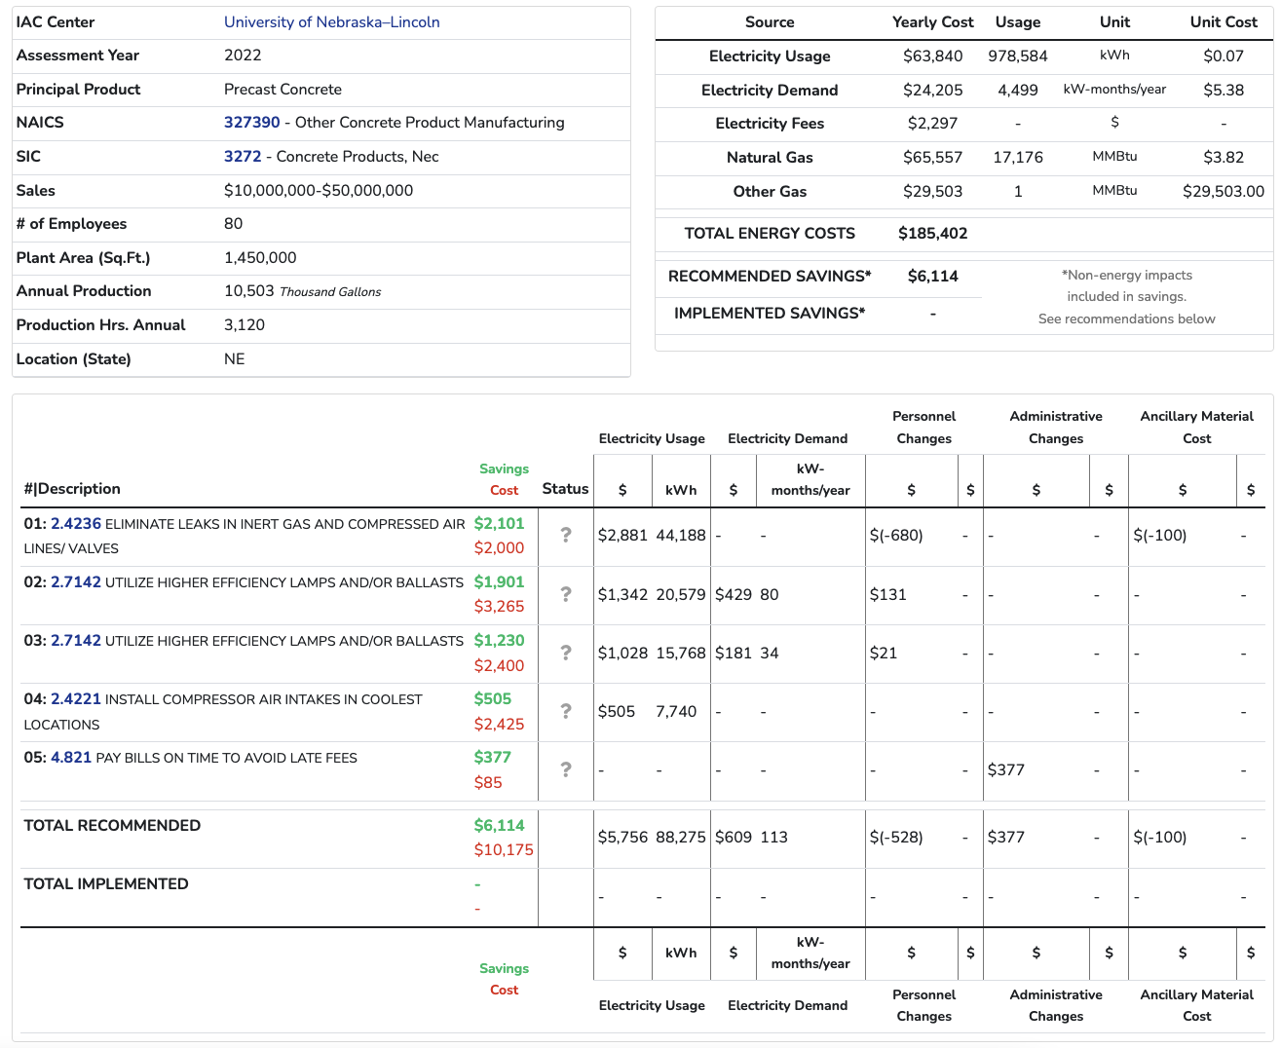

Slide 22


Value of working with IAC
Incentive Opportunities
IAC can connect manufactures to our partners for energy saving incentives and project funding as part of the Energize CT Initiative
Explore multiple financing opportunities with CT Green Bank
Utilize IAC for external audit & identifying recommendations
Connect with other programs/incentives/grants:
New England CHP Technical Assistance Partnership
IAC larger capital project implement grant
Access to Resources
The IAC Team can introduce manufacturers to free internal tools and certifications; examples include but not limited to:
MEASUR Tool
50001 Ready
Better Plants Partnership with the DOE (Long-term goal setting)

Slide 23
Infrastructure Investment & Job’s Act
IACs Nationwide will oversee $550M provided by the Infrastructure Investment & Job’s Act over 5 years
Implementation Grants ($400 of $550M)
Grants to fund larger capital projects with ROIs> 4 years
50% cost-share, grant max = $300,000
How to be eligible?
IAC energy assessment
Project Proposal with goal of:
Increased energy efficiency
Reduced GHG
Implementation Details TBD later this year

Slide 24

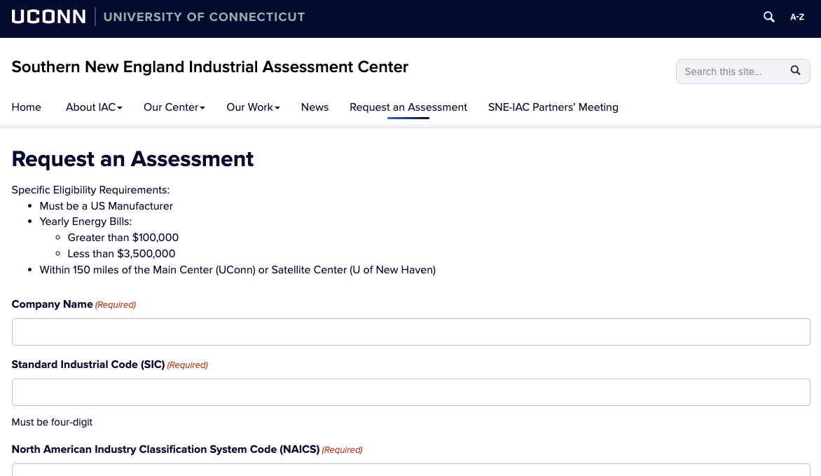
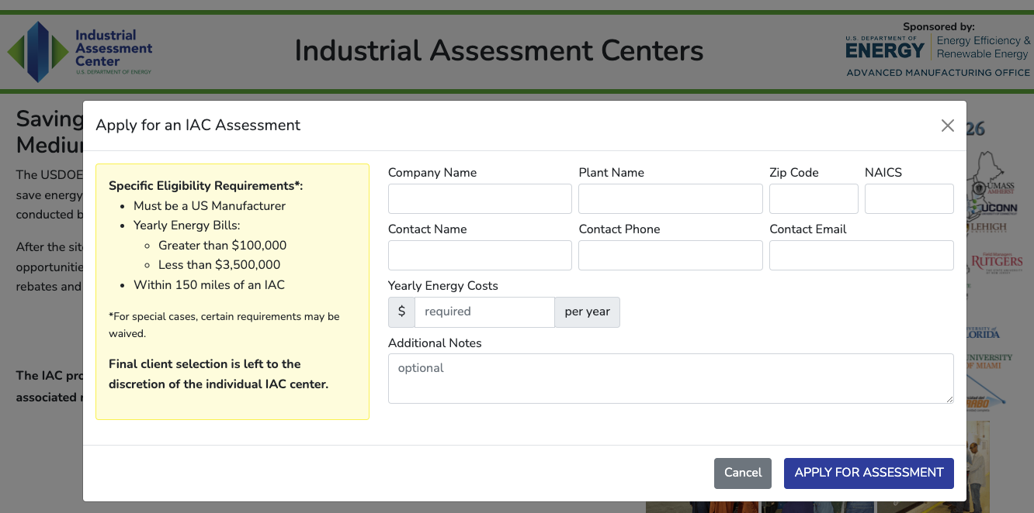
How to sign-up
Request an assessment directly through SNE-IAC Portal
Utilize the IAC Website and choose SNE-IAC Location
Required information for request:
Company Name & Plant Name
SIC & NAICS Code (4 & 6-digit respectively)
Company & Plant Details (including size, yearly sales and energy costs)
https://iac.uconn.edu
https://iac.university

Slide 25
Thank you
We look forward to working with you
Website: https://iac.uconn.edu
E-mail: engr-iac@uconn.edu

